Slide 1
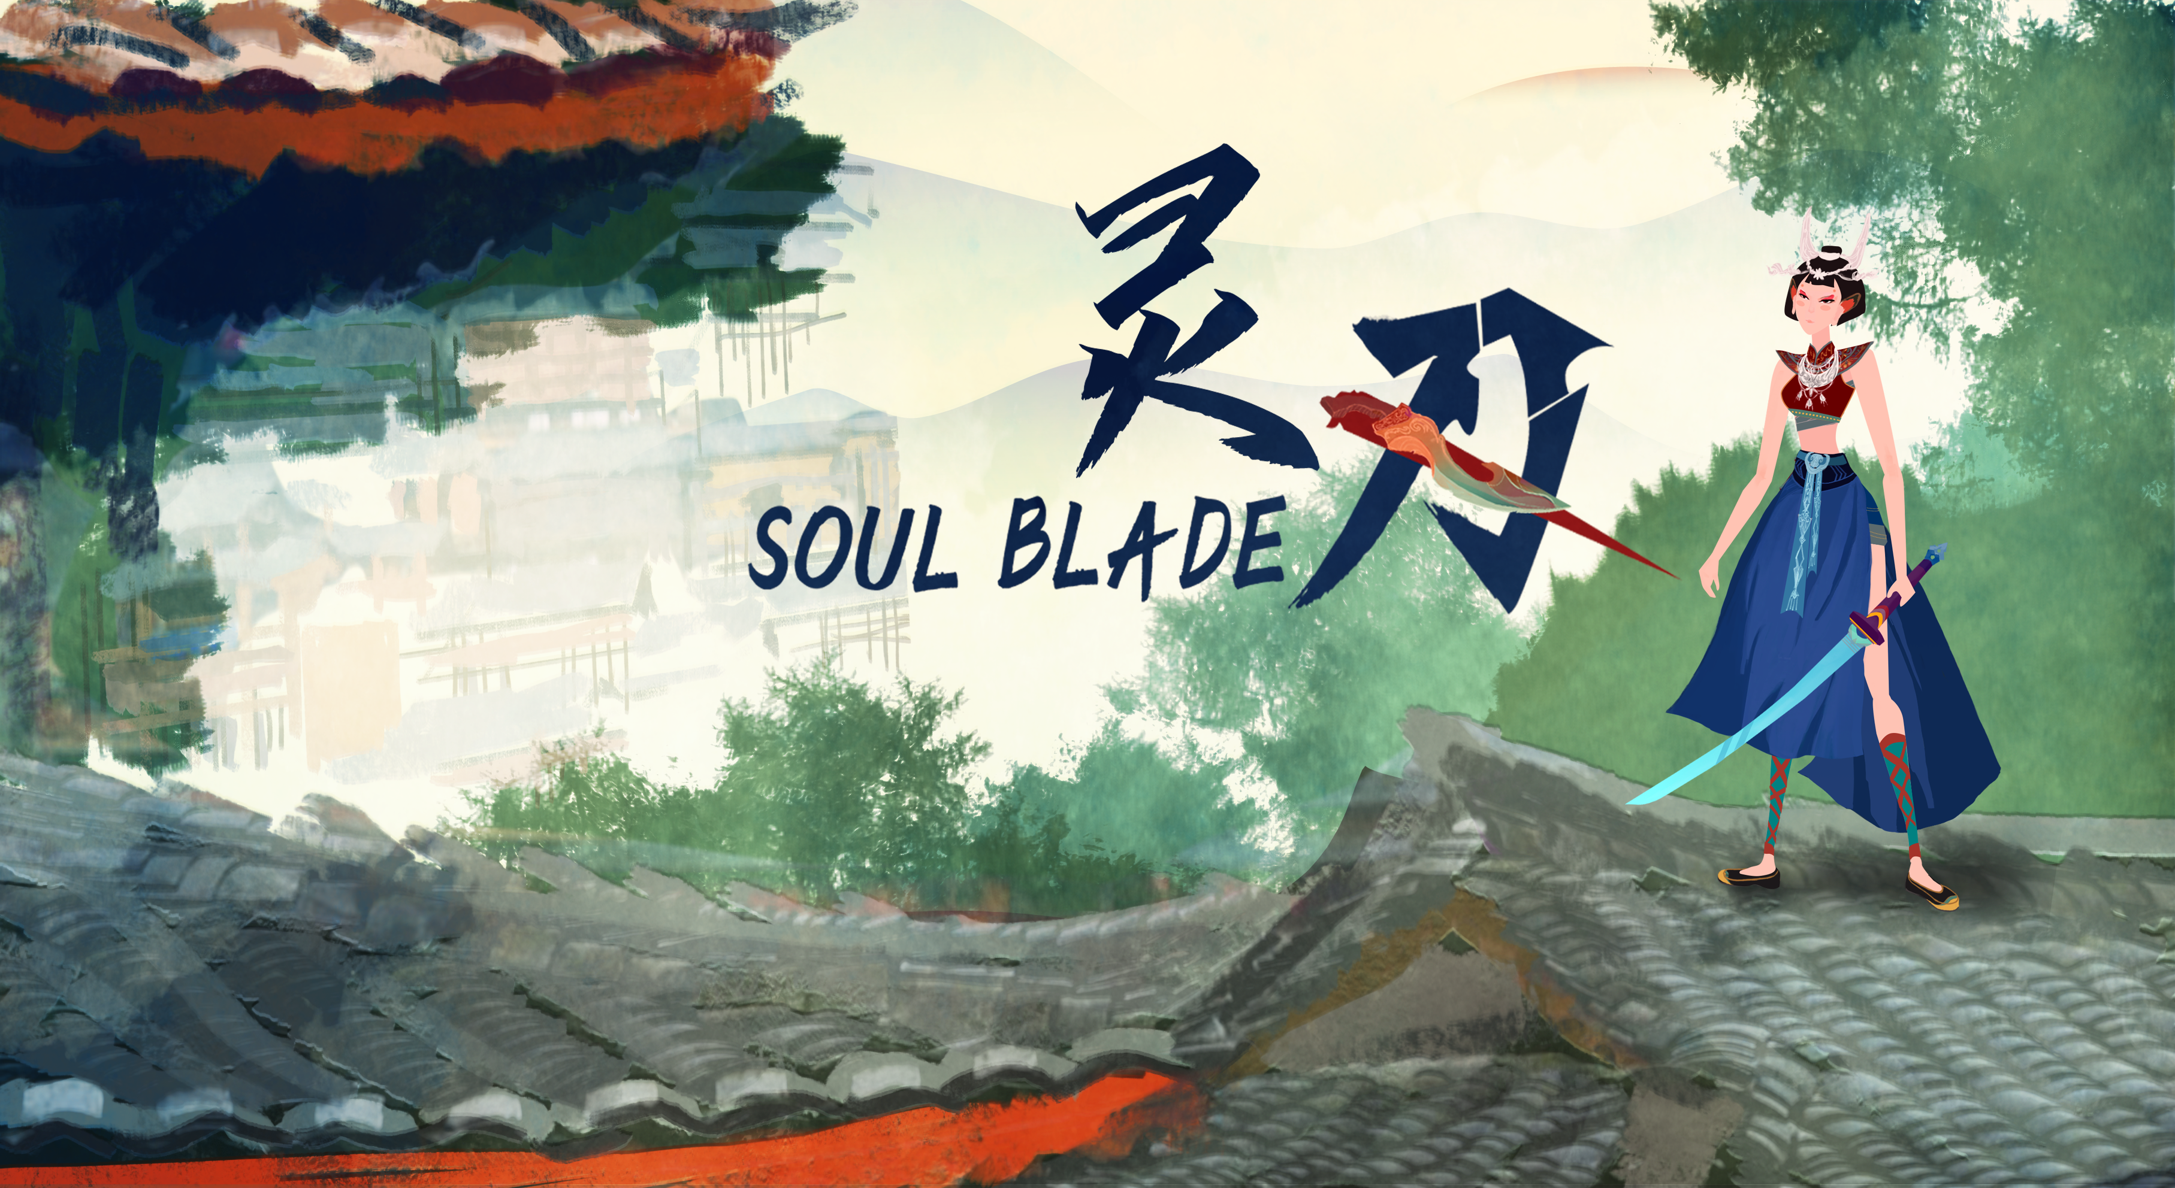
Elder Iron
Version 1.0.9

Slide 2
Abstract
This week our team keep working on Boss Fight:
Added BOSS action/skill animations;
Added melee enemy, melee weapon animations and Ai;
Added character attack/movement VFX, Enemy taken damage VFX;
Added new scene assets and platform level function;
Added character/enemy action SFX

Slide 3

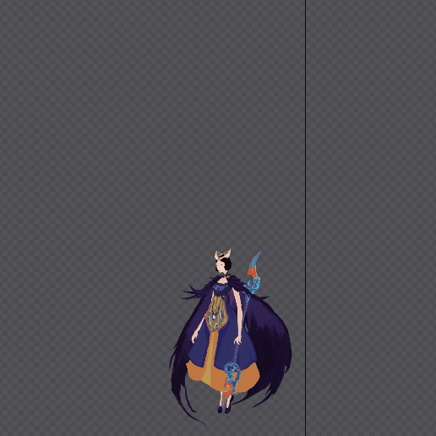
BOSS Skill Animation

Slide 4
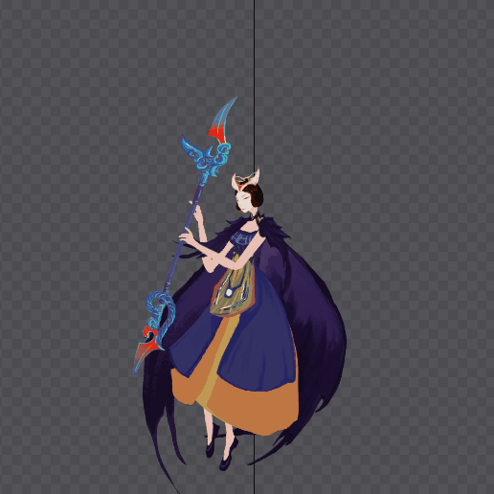
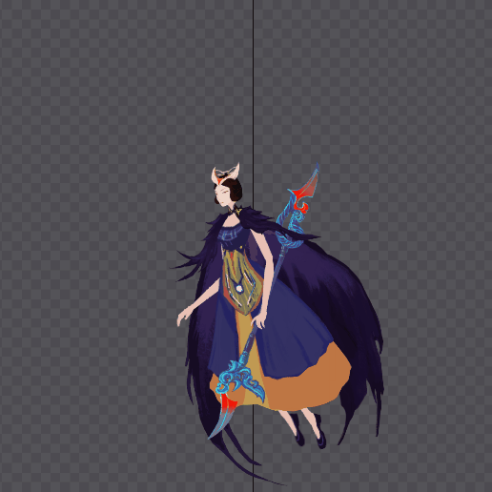
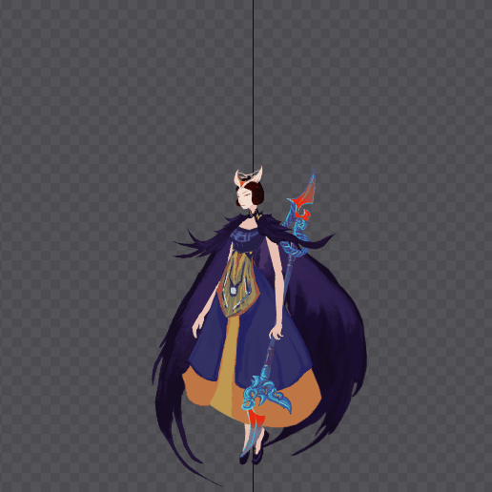
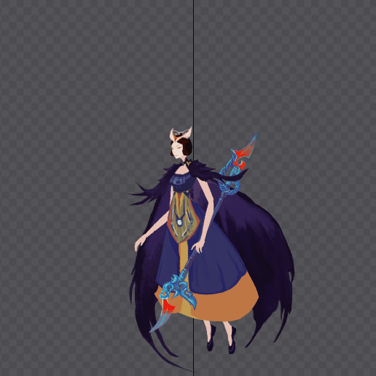
BOSS
Basic animation

Slide 5

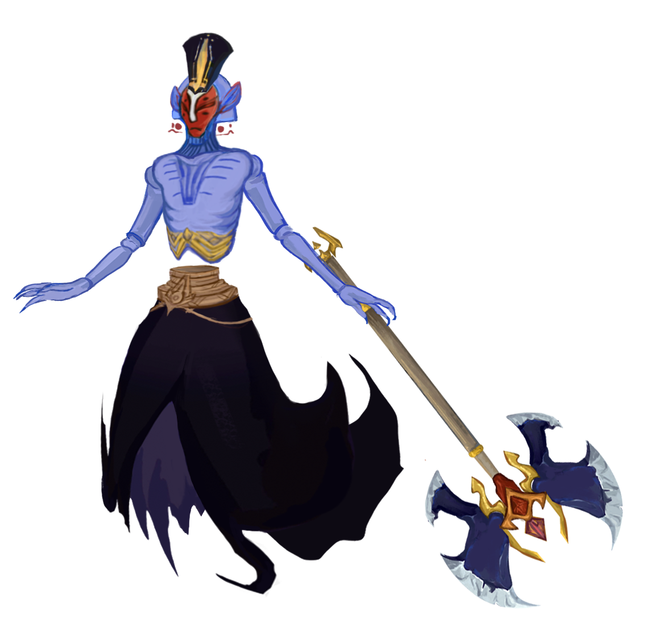
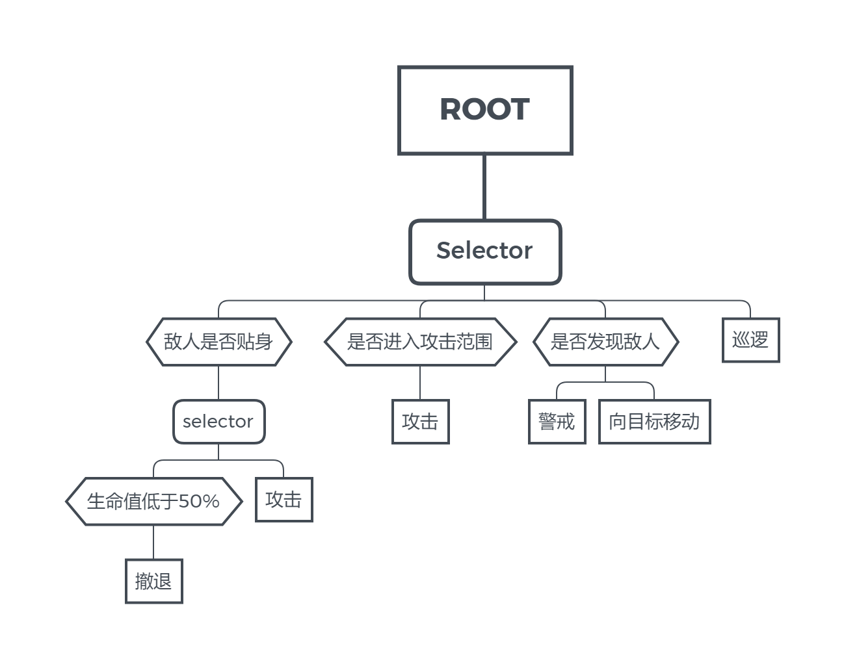
Melee enemy and weapon

Slide 6
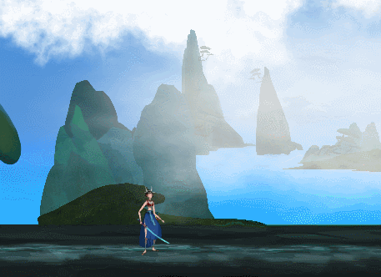
Dash Function and VFX
As an important movement/dodge tool in action games, we added dash to the original combat system this week and completed the special effects. At the same time, combined with the original energy system, the player can selectively move/avoid in the battle.

Slide 7
Next week Plan
Next we will complete the Alpha version of our game：
Boss fight scene(Art)
The rest of Boss skill animation
Complete the whole level and Boss fight
Animation of character/enemy in combat Refine
Added scene assets and Refinement
Added BGM and other SFX

Slide 8
Cheers！

